Slide 1

Visual Storytelling

Slide 2
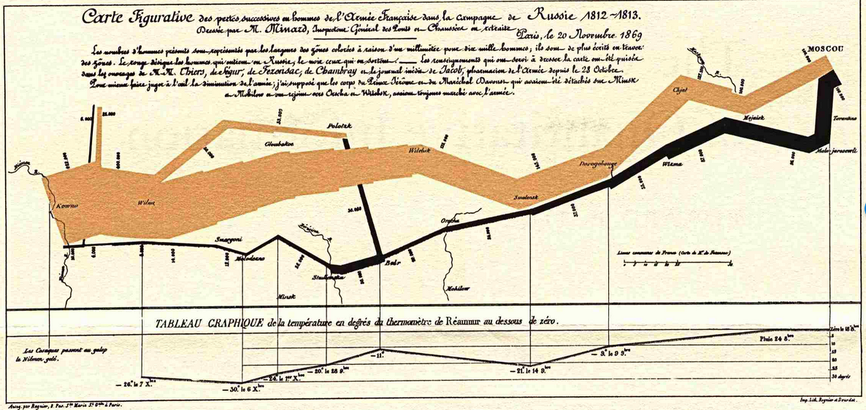
Notes:
Charles Minard eighteen twelve march of Naplean
Tufte “best statistical graphic ever drawn”
Start Polish-Russian border, the thick band shows the size of the army at each position.
retreat from Moscow in the bitterly cold winter is depicted by the dark lower band,
which is tied to temperature and time scales.

Slide 3
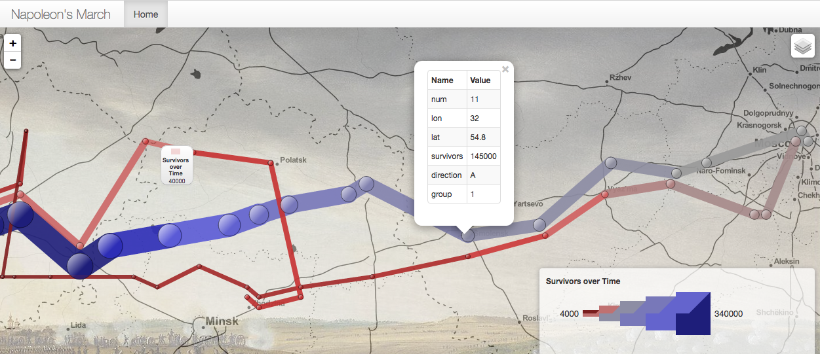
http://humangeo.github.io/leaflet-dvf/examples/html/minard.html#
Notes:
Here we have an interactive version that actually doesn’t do as good a job of highlighting. Technology and having greater amount of ways of updating, showing, and interacting with data.

Slide 4
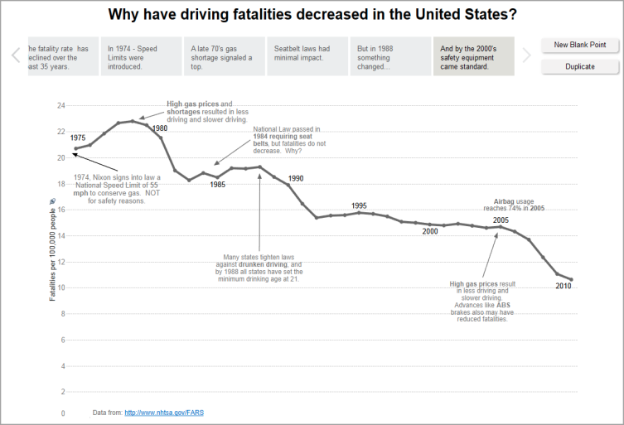
https://onlinehelp.tableau.com/current/pro/desktop/en-us/stories.html
Notes:
Using story sheets in Tableau
Many narratives with an start middle and end
Provides an overview in the past 35 years
Different events including seat belt laws to discuss impact (or lack theeof)

Slide 5
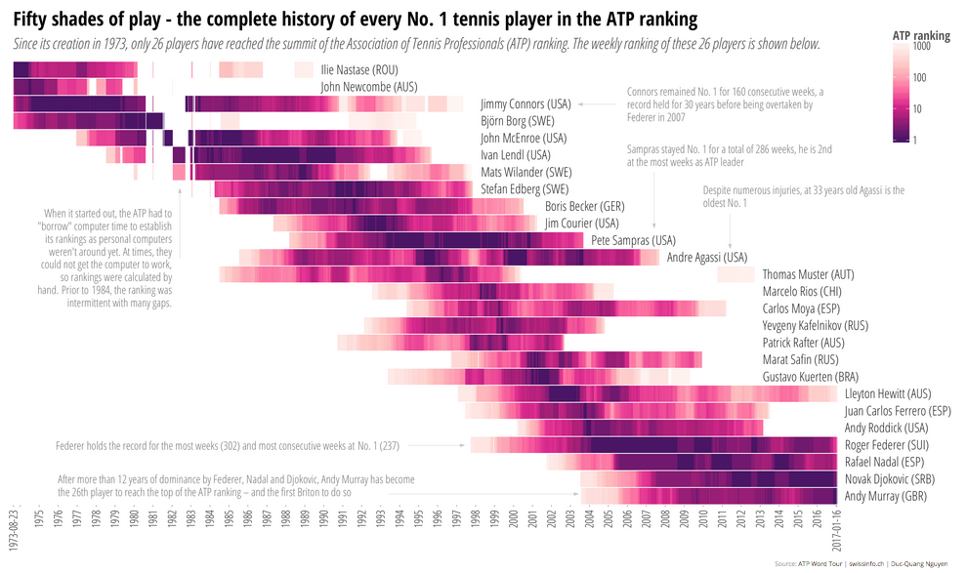
Source: http://www.swissinfo.ch/eng/who-is-the-best-_the-complete-history-of-every-no--1-tennis-player/42274984
Notes:
Since 1973 only a handful have reached the top of the tennis rankings
Early 1980s had to borrow computer time for ranking, sometimes didn’t work so gaps
Single page story

Slide 6
“It’s more common NOT to publish than to publish.”
Sarah Cohen, editor of New York Times computer-assisted reporting team

Slide 7
Tools for analysis
=
Tools for presentation
Notes:
“Visualization researchers often tacitly assume that the tools used for analysis are usable for presentation just as well as for their original purpose. We believe that to be a very limiting assumption.” Robert Kosera and Jock Mackinlay of Tableau research.
http://dataplusscience.com/files/Kosara_Computer_2013.pdf

Slide 8
Tools for analysis
=>
Tools for presentation
Notes:
Tools for analysis inform presentation
http://dataplusscience.com/files/Kosara_Computer_2013.pdf

Slide 9
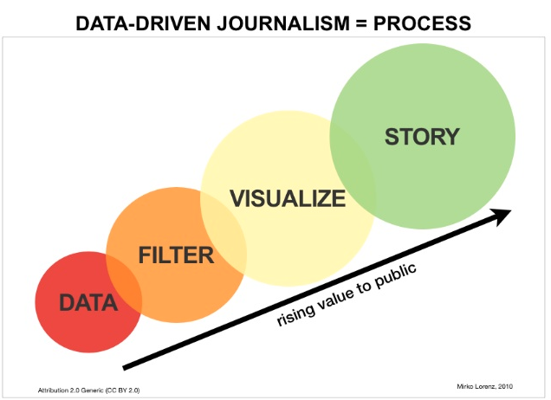
Notes:
Think back to visualization supporting insights/ tasks – insights for who and when? Have the insights for you as the data scientist and analyst and then communicating those to a broader audience. MIRKO LORENZ

Slide 10
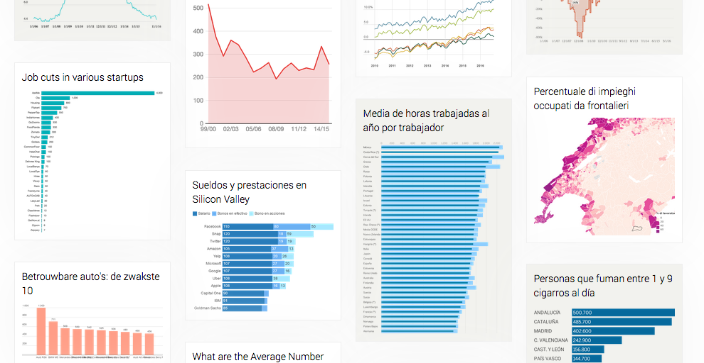
https://github.com/datawrapper
https://www.datawrapper.de
Notes:
Datawrapper an opensource library in JS

Slide 11
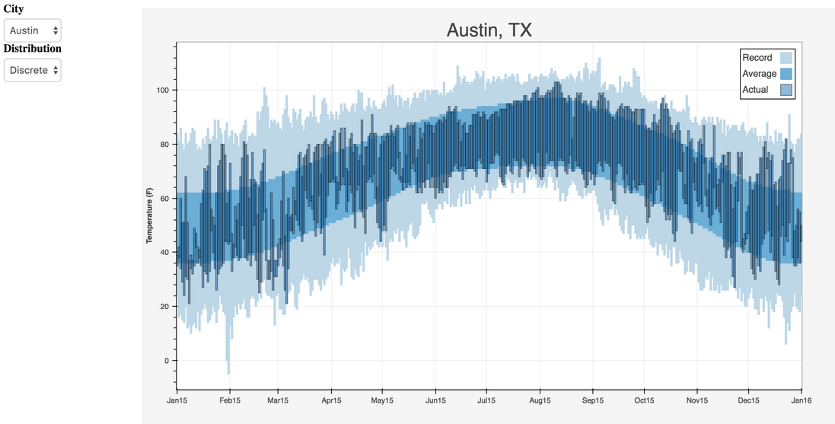
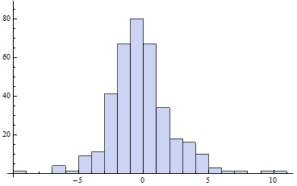
Histogram:http://motls.blogspot.com/2011/09/austin-texas-all-daily-trends-since.html
Austin Temp. Chart: https://blog.modeanalytics.com/images/post-images/viz-libraries-04.png
Notes:
Examples overlayed on graphic of how visualization you create for analysis are different than presentation.

Slide 12
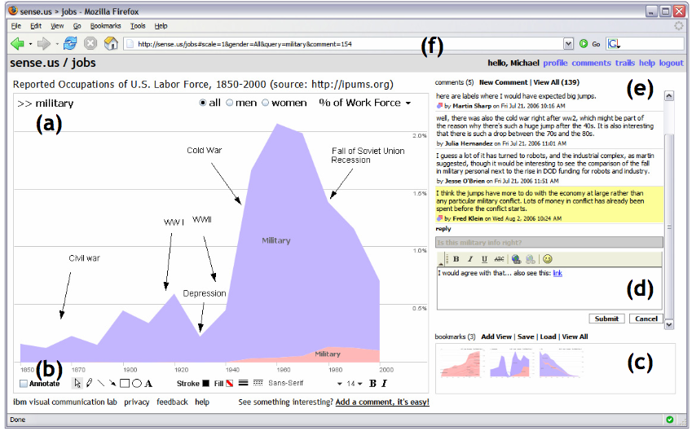
Collaborative Analysis/Stories
http://hint.fm/papers/2007-sense.us-CHI.pdf
Notes:
With some notable possible exceptions such as a social tool where the exploration and presentation are co-occuring, but even then you can bet that there were visualizations for analysis before making choices around the social presentation.

Slide 13
Communicate
a Process
Notes:
Data science stories as a process

Slide 14
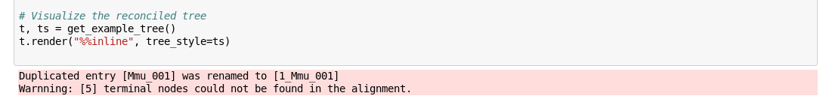
Processes are messy!
Code Image Source: http://etetoolkit.org/static/img/notebook.alg.png
Notes:
In the process of analysis there are bumps along the way as we’ve learned.

Slide 15
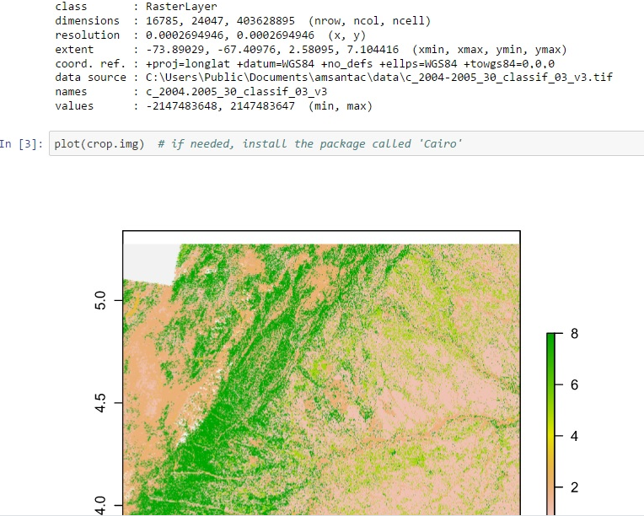
Reproducibility
Image Source: http://amsantac.co/images/2016-06-29-reproducibility-arcpy-jupyter-notebook-r-fig-8.jpg
Notes:
http://amsantac.co/images/2016-06-29-reproducibility-arcpy-jupyter-notebook-r-fig-8.jpg

Slide 16
Communicate
the Findings
Notes:
Several genres. These include.

Slide 17
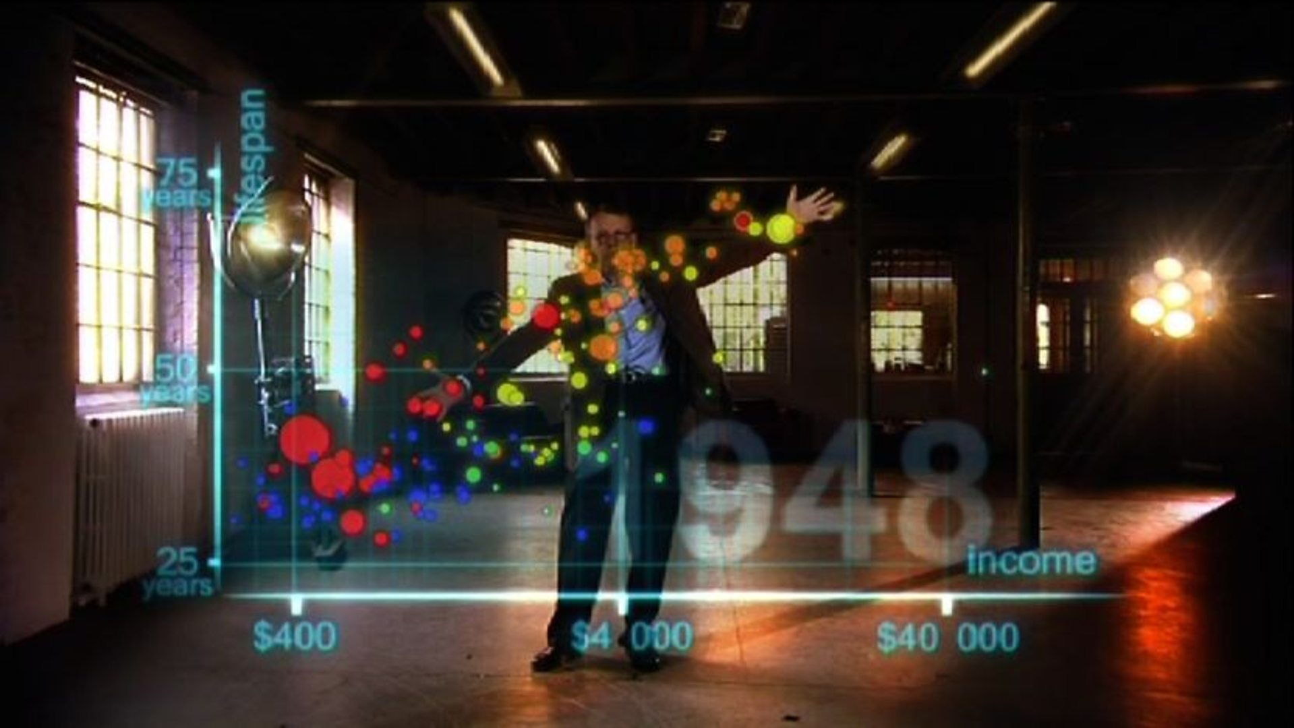
https://ichef.bbci.co.uk/images/ic/1920x1080/p02c35nh.jpg

Slide 18
Who/what is presenting?
Who is the audience?
What are the affordances for the presentation?
How might the story get passed along?

Slide 19

Changing Stories
Image Source: http://www.ancient-origins.net/myths-legends/
Notes:
If self directed.
http://www.ancient-origins.net/myths-legends/story-ragnarok-and-apocalypse-001352

Slide 20
Data Provenance
Citing and or/linking:
- Data sources
- Methodological choices and relevant facts
Annotating exceptions and corrections
(Hullman & Diakopoulos, 2011)
Notes:
http://faculty.washington.edu/jhullman/vis_rhetoric.pdf
Visualization Rhetoric: Framing Effects in Narrative Visualization

Slide 21
Representing Uncertainty
Visually (e.g., error bars),
OR textually by describing:
Inferential limits
Forecast annotations
Extrapolated data points (labels)
Doubt regarding possible conclusions
(Hullman & Diakopoulos, 2011)

Slide 22
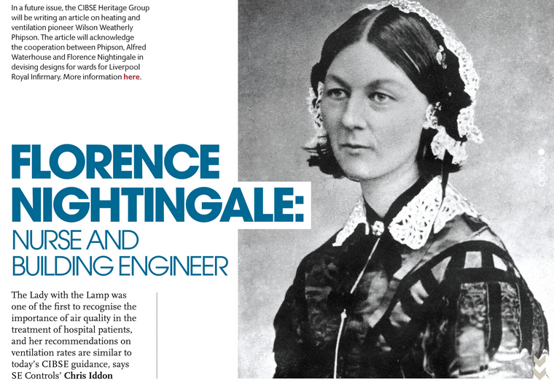
The Storyteller
Image Source http://portfolio.cpl.co.uk/CIBSE/201505/profile-florence-nightingale/
Notes:
Bios for authorship can provide further info about the designer and give context for possible bias that might have arisen.
Original data story tellers

Slide 23


